Slide 1
Number Bases & Units
To understand number bases commonly used in Computer Science
To be able to explain the advantages of using Hexadecimal over binary in some situations
To be able to give some examples of where each of these number systems are used
To be able to convert to and from denary/binary /hexadecimal

Slide 2
Number Bases & Units
To understand number bases commonly used in Computer Science
Specification Points
3.5.2.1 Number base
3.5.3.1 Bits and bytes
3.5.3.2 Units

Slide 3
Number Bases & Units
To understand number bases commonly used in Computer Science
Number Bases
A number base indicates how many different digits are available when using a particular number system.
Decimal is number base 10 which means that it uses ten digits: 0, 1, 2, 3, 4, 5, 6, 7, 8 and 9.
Binary is number base 2 which means that it uses two digits: 0 and 1.
Hexadecimal is number base 16 which means it uses sixteen digits/characters:
0, 1, 2, 3, 4, 5, 6, 7, 8, 9, A, B, C, D, E, F
A in Hex has the denary value 10.
B in Hex has the denary value 11
F in Hex has the denary value 15

Slide 4
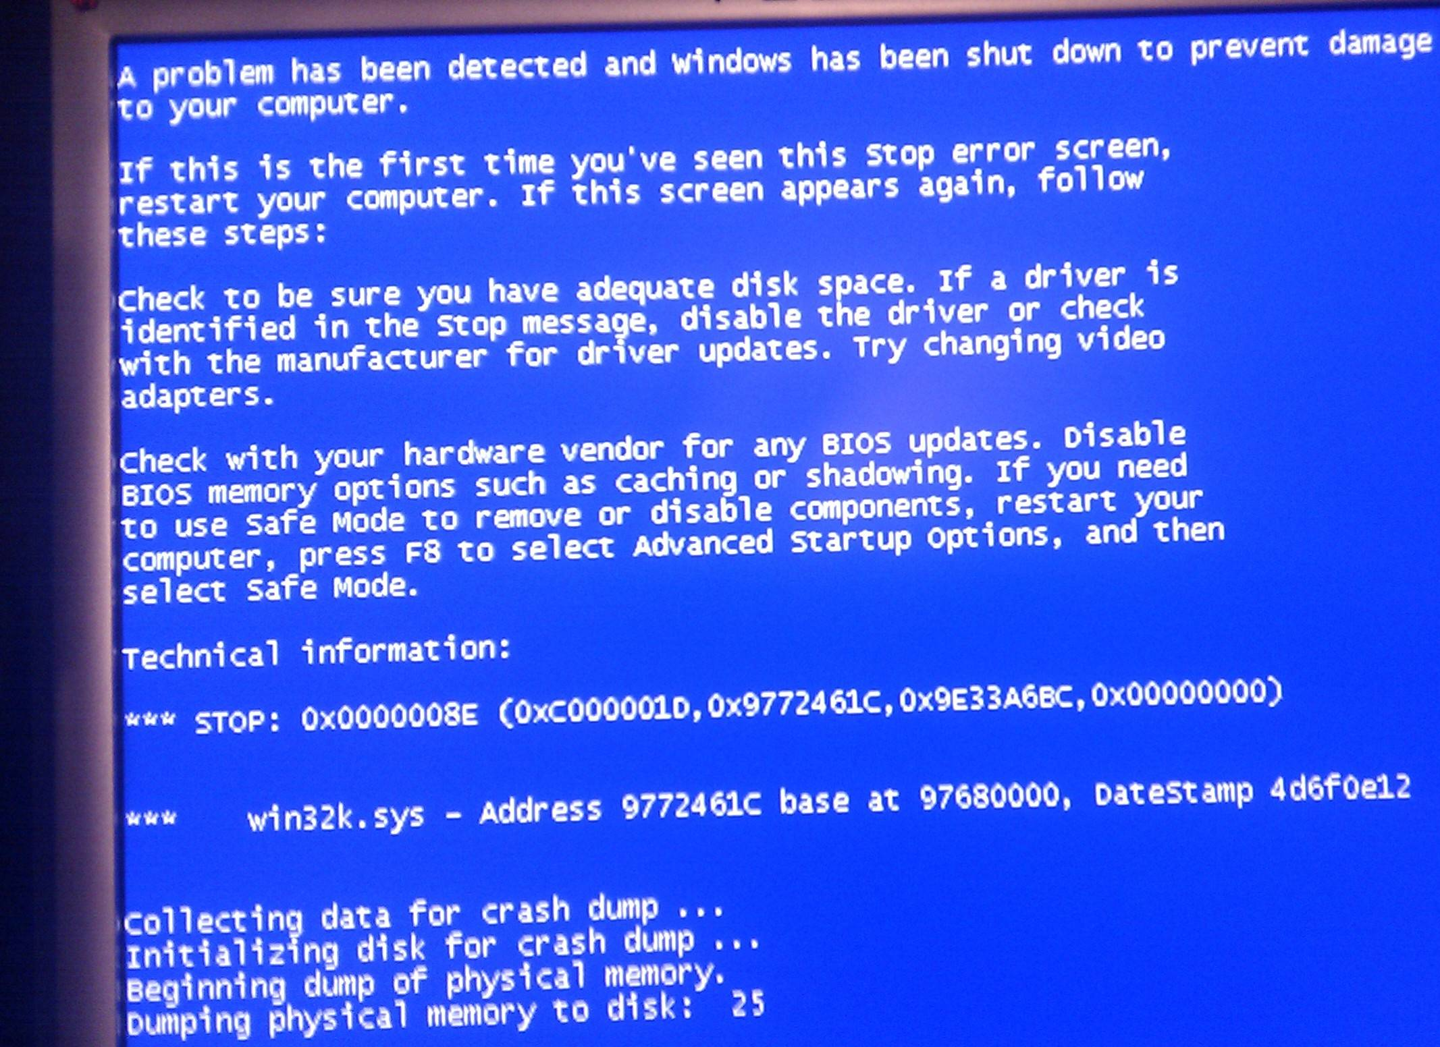
Number Bases & Units
To understand number bases commonly used in Computer Science
Hexadecimal
Hexadecimal or hex is particularly useful for representing large numbers as fewer digits are required.
Hex is used in a number of ways.
Memory addresses are shown in hex format, as are colour codes.
The main advantage of hex is that two hex digits represent one byte.
As it is number base 16, hex uses 16 different digits: 0 to 9 and A to F.

Slide 5
Number Bases & Units
To understand number bases commonly used in Computer Science
Number Bases - Uses
Different number bases are needed for different purposes.
Humans use number base 10, whereas computers use binary as this represents digital data.
Subscript numbers are used to show what number base is being used. For example:
43₁₀ is decimal
1011₂ is binary
2A7₁₆ is hexadecimal.

Slide 6
Number Bases & Units
To understand number bases commonly used in Computer Science
Number Bases – place values
Base 10 – Denary / Decimal
10⁷ | 10⁶ | 10⁵ | 10⁴ | 10³ | 10² | 10¹ | 10⁰
Base 2 – Binary
2⁷ | 2⁶ | 2⁵ | 2⁴ | 2³ | 2² | 2¹ | 2⁰
Base 16 – Hexadecimal
16⁷ | 16⁶ | 16⁵ | 16⁴ | 16³ | 16² | 16¹ | 16⁰

Slide 7
Number Bases & Units
To understand number bases commonly used in Computer Science
Number Bases – place values
Base 10 – Denary / Decimal
10000000 | 1000000 | 100000 | 10000 | 1000 | 100 | 10 | 1
Base 2 – Binary
128 | 64 | 32 | 16 | 8 | 4 | 2 | 1
Base 16 – Hexadecimal
268435456 | 16777216 | 1048576 | 65536 | 4096 | 256 | 16 | 1

Slide 8
Number Bases & Units
To understand number bases commonly used in Computer Science
Binary to decimal conversions
Binary numbers are converted to decimal integers as follows:
Write down a binary number (e.g. 10000111).
Above the number, starting from the least significant bit (LSB) on the righthand side, write the number 1.
As you move left from the LSB to the most significant bit (MSB), double the value of the previous number.
Wherever there is a 1, add the decimal value.
The above example represents:
one 128, one 4, one 2 and one 1
giving a total value of
135 (128 + 4 + 2 + 1 = 135).
Therefore 10000111 in binary equals 135 as a decimal integer.
MSB
LSB
128 | 64 | 32 | 16 | 8 | 4 | 2 | 1
1 | 0 | 0 | 0 | 0 | 1 | 1 | 1

Slide 9
Number Bases & Units
To understand number bases commonly used in Computer Science
Decimal to binary conversions
To convert a decimal integer to a binary number, use the same method, but working the other way.
Another way of carrying out this calculation is to carry out repeated divisions on the decimal number.
MSB
LSB
128 | 64 | 32 | 16 | 8 | 4 | 2 | 1

Slide 10
Number Bases & Units
To understand number bases commonly used in Computer Science
Decimal to binary conversions
To convert 98:
98 divide by 2 = 49 with a remainder of 0
49 divide by 2 = 24 with a remainder of 1
24 divide by 2 = 12 with a remainder of 0
12 divide by 2 = 6 with a remainder of 0
6 divide by 2 = 3 with a remainder of 0
3 divide by 2 = 1 with a remainder of 1
1 divide by 2 = 0 with a remainder of 1
Reading from the bottom we get 1100010, which is the binary equivalent of 98.
MSB
LSB
128 | 64 | 32 | 16 | 8 | 4 | 2 | 1
0 | 1 | 1 | 0 | 0 | 0 | 1 | 0

Slide 11
Number Bases & Units
To understand number bases commonly used in Computer Science
Hexadecimal / denary conversions
A common approach to convert decimal integers to hex is to first convert the decimal to binary and then convert the binary to hex.
To convert binary to hex, split the binary number into two groups of four bits and convert each into the hex equivalent.
Hexadecimal
5F
8 4 2 1
8 4 2 1
0101 1111
It works both ways
Binary
128 64 32 16 8 4 2 1
0 1 0 1 1 1 1 1
Decimal
95

Slide 12
Number Bases & Units
To understand number bases commonly used in Computer Science
Questions
1. Explain why computers can only process data in binary form.
2. What is the biggest decimal integer you can represent with the following?
4 bits
8 bits
16 bits
3. How many different permutations of numbers can you represent with the following?
4 bits
8 bits
16 bits
20 bits
24 bits

Slide 13
Number Bases & Units
To understand number bases commonly used in Computer Science
Questions
4.Convert the following decimal numbers into binary:
10, 12, 15, 65, 165
5. Some programming languages use hexadecimal. Explain what hexadecimal is and what the benefits are of using this system, compared to binary or decimal.
6. Convert the following hexadecimal numbers into binary:
10, 12, 1F, F1
7. Convert the following hexadecimal numbers into decimal:
E, 21, 17, AB

Slide 14
Number Bases & Units
To understand number bases commonly used in Computer Science
Answers
1. Explain why computers can only process data in binary form. Computer processes are digital and handle pulses of electricity as either on or off, which can be represented as 0s and 1s. 0 and 1 is binary.
2. What is the biggest decimal integer you can represent with the following?
4 bits - 15 (16 numbers 0 to 16) 8 bits - 255 (256 numbers 0 to 255) 16 bits - 65355 (65356 numbers 0 to 65355)
3. How many different permutations of numbers can you represent with the following?
4 bits – 16
8 bits - 256
16 bits - 65356
20 bits - 1048576
24 bits - 1677216

Slide 15
Number Bases & Units
To understand number bases commonly used in Computer Science
Answers
4. Convert the following decimal numbers into binary:
10 - 1010
12 - 1100
15 - 1111
65 - 1000001
165 - 10100101
5. Some programming languages use hexadecimal. Explain what hexadecimal is and what the benefits are of using this system, compared to binary or decimal. Hex is number base 16, using the numbers 0 to 9 and the characters A to F. As it uses a larger number base, fewer digits are needed than binary to represent the same value. For example, 15 in binary is 1111 whereas in hex it is F. The implications of this are that it takes less space on screen or print-out, is easier to recognise code patterns, and hence less likely to make mistakes.

Slide 16
Number Bases & Units
To understand number bases commonly used in Computer Science
Answers
5.Convert the following hexadecimal numbers into binary:
10 - 10000
12 - 10010
1F - 11111
F1 - 11110001
6. Convert the following hexadecimal numbers into decimal:
E - 14
21 - 33
17 - 23
AB - 171

Slide 17
Number Bases & Units
To understand number bases commonly used in Computer Science
The bit
A bit is a Binary Digit.
The processor can only handle electricity in a relatively simple way – either electricity is flowing, or it is not.
This is often referred to as two states.
The processor can recognise whether it is receiving an off signal or an on signal.
This is handled as a zero (0) for off and a one (1) for on.
Each binary digit therefore is either a 0 (no signal) or a 1 (a signal).
Computers string 0s and 1s together to represent text, numbers, sound, video and everything else we use our computers for.

Slide 18
Number Bases & Units
To understand number bases commonly used in Computer Science
The byte
A single byte is a string of eight bits.
Eight is a useful number of bits as it creates enough permutations (or combinations) of zeros and ones to represent every character on your keyboard.
With one bit we have two permutations: 0 and 1.
With two bits we have four permutations: 00, 01, 10 and 11. This could be represented as 2² or 2 × 2. As we increase the number of bits, we increase the number of permutations by the power of two.
Three bits would give us 2³ which is 2 × 2 × 2 = 8 permutations.
Four bits would give us 2⁴ permutations which is 2 × 2 × 2 × 2 = 16 permutations.
Eight bits would give us 2⁸ permutations which is 256 permutations.

Slide 19
Number Bases & Units
To understand number bases commonly used in Computer Science
Questions
How many different permutations can 6 bits hold?
What is the maximum value that can be represented using:
4 bits
5 bits
8 bits
If one byte can hold one ASCII character (a characters on your keyboard), how many characters can be represented using:
32 bits
40 bits
How many ASCII characters can be stored using 2 kilobytes?

Slide 20
Number Bases & Units
To understand number bases commonly used in Computer Science
Answers
How many different permutations can 6 bits hold? 64 (2^6)
What is the maximum value that can be represented using:
4 bits - 16
5 bits - 32
8 bits - 255
If one byte can hold one ASCII character (a character on your keyboard), how many characters can be represented using:
32 bits - 4
40 bits - 5
How many ASCII characters can be stored using 2 kilobytes?
1024 bytes in a kilobyte
2048 bytes in 2 kilobytes
2048 ASCII characters can be held in 2 kilobytes

Slide 21
Number Bases & Units
To understand number bases commonly used in Computer Science
Units
Bytes are combined together into larger units:
Binary kibibyte Ki 2¹⁰ mebibyte Mi 2²⁰ gibibyte Gi 2³⁰ tebibyte Ti 2⁴⁰ | Decimal kilobyte k 10³ megabyte M 10⁶ gigabyte G 10⁹ terabyte T 10¹²
Additional reading: http://blog.forret.com/2005/02/04/binary-confusion-kilobytes-and-kibibytes/

Slide 22
Number Bases & Units
To understand number bases commonly used in Computer Science
Questions
5. Identify a situation where it would be appropriate to use the following units of measurement:
Kilobyte
A compressed image file, a text email, a text document with only a few pages.
Megabyte
High-resolution graphics files, music files, large documents, databases, executables for large programs.
Terabyte
Large datasets such as those referred to as big data.

Slide 23
Number Bases & Units
To understand number bases commonly used in Computer Science
Prep 1
Research and write down common capacities for the following devices:
Hard Disk
Main memory / RAM
Memory stick
SD Card
Floppy disk
CD-ROM
DVD-ROM
Blue Ray Disc
Prep 2
In Java, the Int data type is a 32-bit signed two's complement integer.
What does this mean?

Slide 24





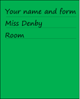






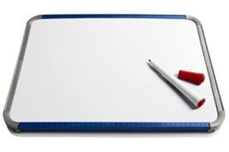


Key words:
Noted clearly
Topic specific vocabulary wherever necessary
Icon for extension activity if appropriate
Icon same colour as dept ex book
You might want to develop subject specific icons

